Slide 1
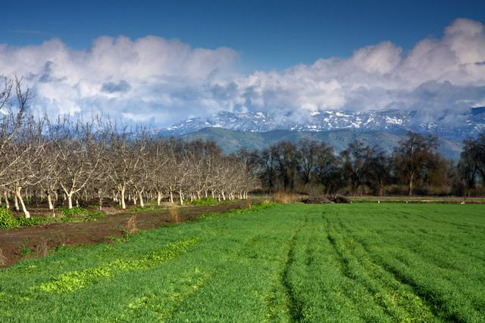

Ecosystem Services and Working Landscapes
Photo: Greening, 2009.
Market Mechanisms to Fund Conservation
Prepared by Daniel O’Connell, Ph.D., and Adam Livingston with support from

Slide 2
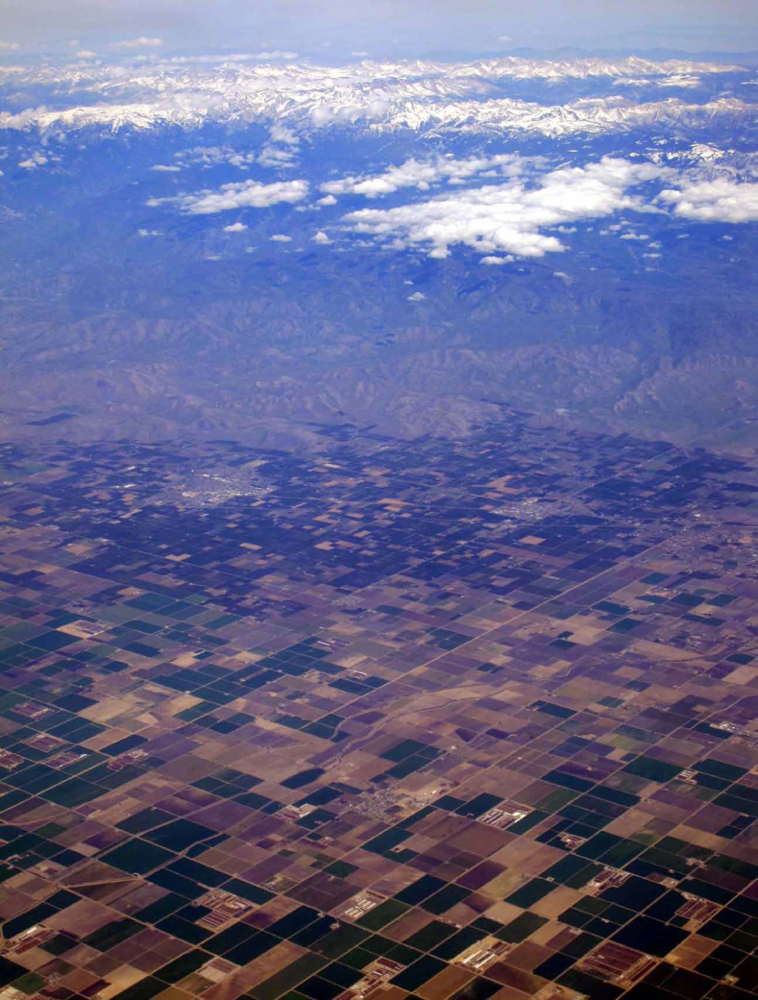
Overview
Working landscapes
Ecosystem services
  Types of services
  Existing markets
An ecosystem services agenda for CA land trusts
  Creating and expanding markets
  Supporting participation
  Enhancing mapping capabilities
Photo: Huber, 2014 (from Thorne et al., 2014).

Slide 3
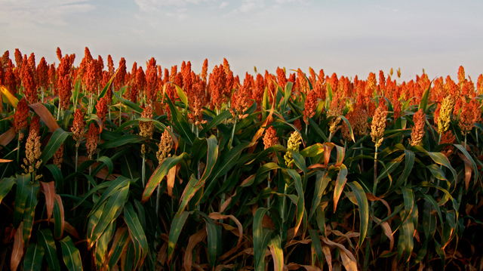
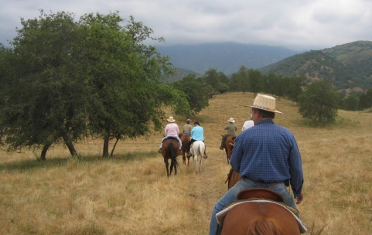
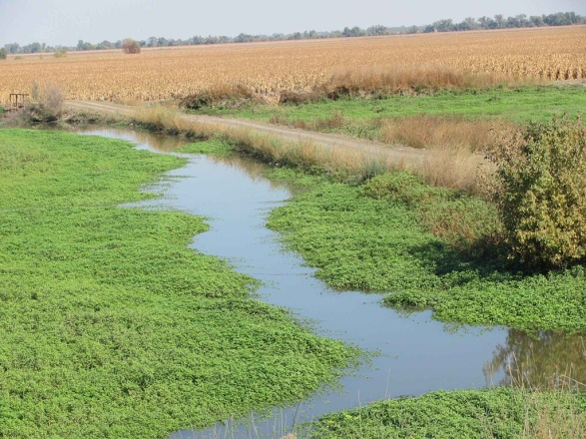
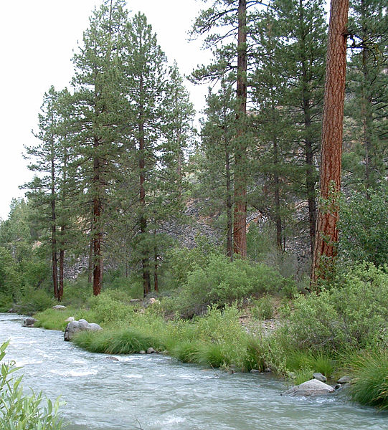
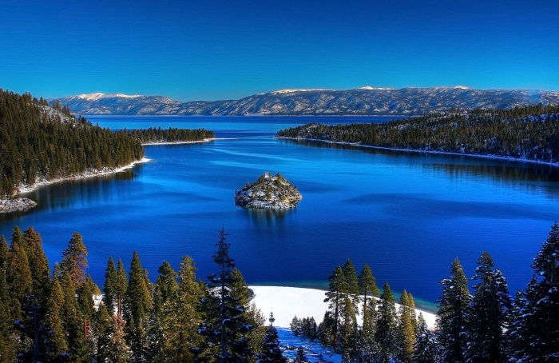
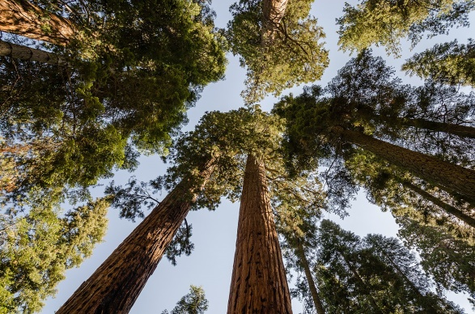
Working Landscapes
CA Economic Summit definition: “farmland, ranches, forests, wetlands, mines, water bodies and other natural resource lands, both private and public”
Photos (clockwise from upper left): Greening, 2009; SRT, 2005; USFWS, 2013; Tuxyso, 2013; USFS, 2004; Michael, 2009.

Slide 4
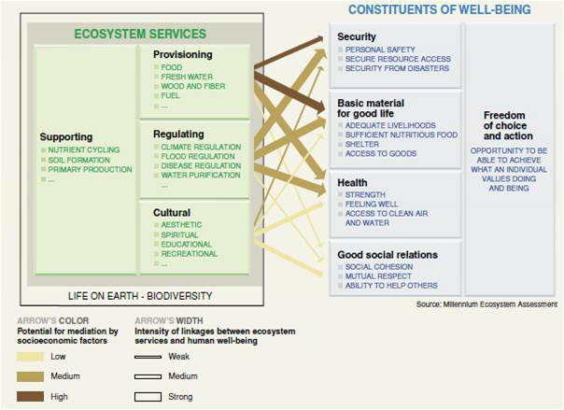
Ecosystem Services
Image: MA, 2005.

Slide 5
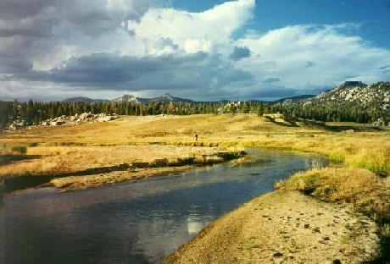
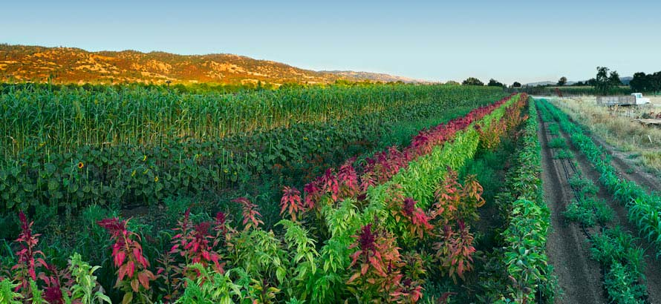
Ecosystem Services
Provisioning
  Water provision
  Agricultural production
Regulating
Cultural
Supporting
Photos: DFW, 2010; UC Berkeley, 2016.

Slide 6
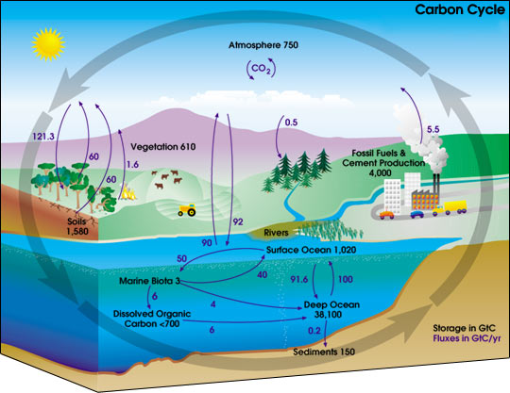
Ecosystem Services
Provisioning
Regulating
  Climate
  stability
Cultural
Supporting
Image: NASA, 2006.

Slide 7
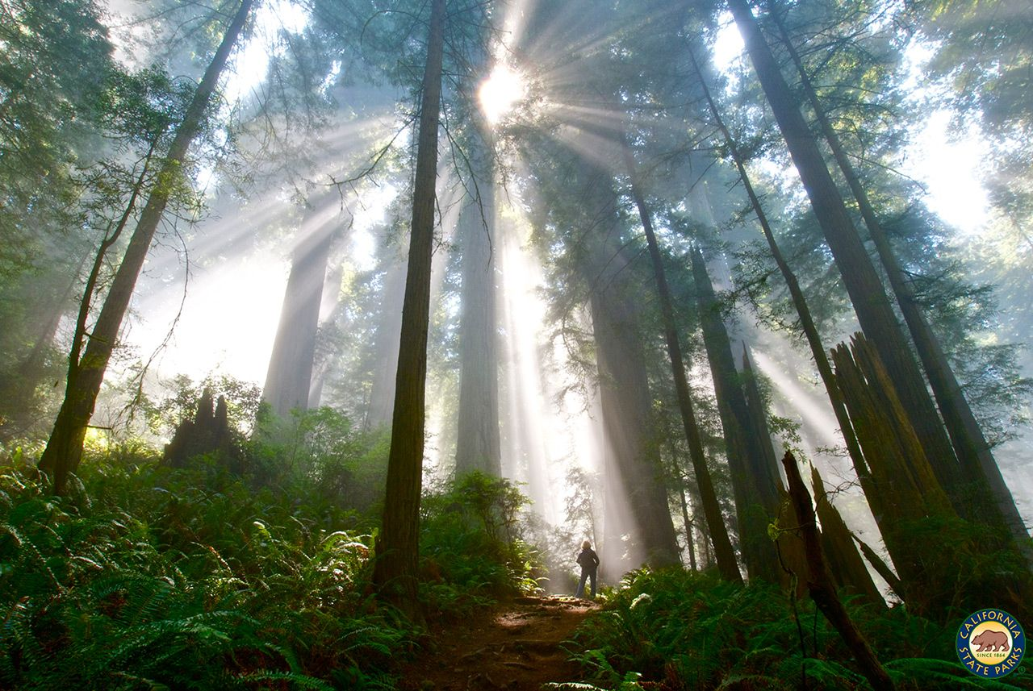
Ecosystem Services
Provisioning
Regulating
Cultural
  Recreation
  and tourism
Supporting
Photo: CA State Parks, 2017.

Slide 8
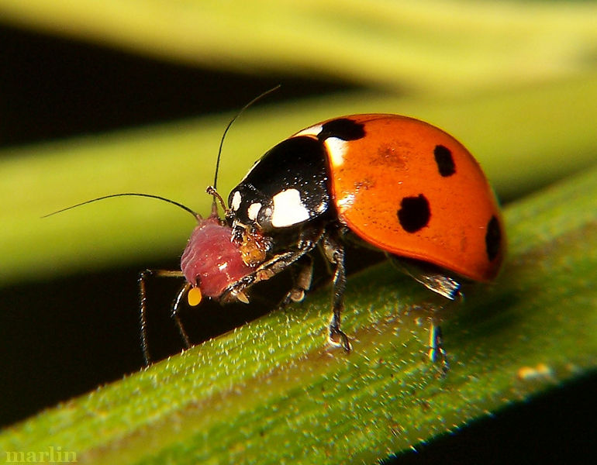
Ecosystem Services
Provisioning
Regulating
Cultural
Supporting
  Biodiversity
Photo: Cirrusimmage, 2016.

Slide 9
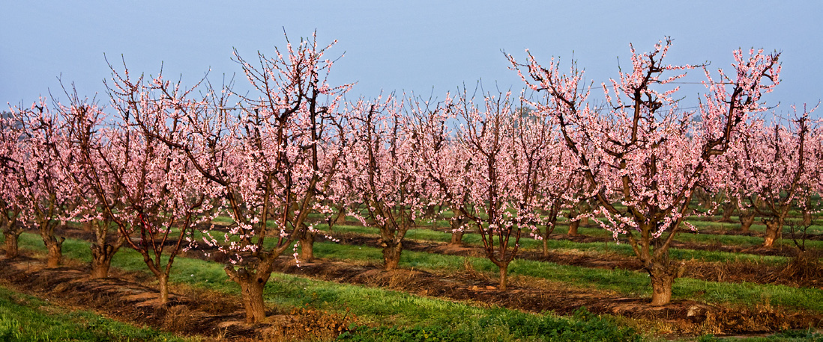
An Ecosystem Services Agenda for CA Land Trusts
Creating and Expanding Markets:
Enhanced Infrastructure Financing Districts (EIFDs) for natural water infrastructure
Expand existing
markets for
conservation
  Farmland and rangeland
  Habitat
  Carbon sequestration
Photo: Greening, 2010.

Slide 10
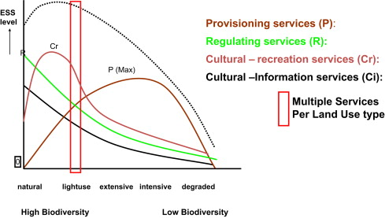
An Ecosystem Services Agenda for CA Land Trusts
Creating and Expanding Markets:
Integrate markets for agricultural practices
that provide multiple ecosystem services
Image: MA, 2005.

Slide 11
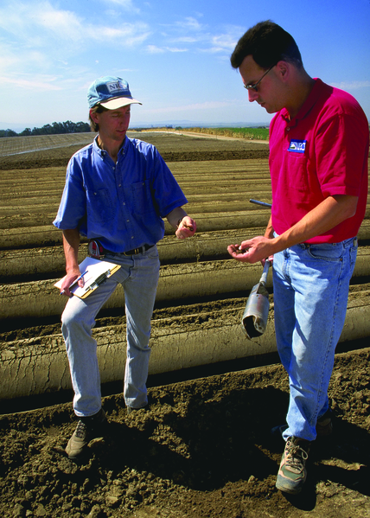
An Ecosystem Services Agenda for CA Land Trusts
Supporting Participation:
Provide regulatory
incentives
Design programs to
be responsive to
participants’ needs
Provide technical
assistance
Photo: NRCS, 2011.

Slide 12
An Ecosystem Services Agenda for CA Land Trusts
Enhancing Mapping Capabilities:
Support mapping technology integration
Image: SACOG, 2016.

Slide 13
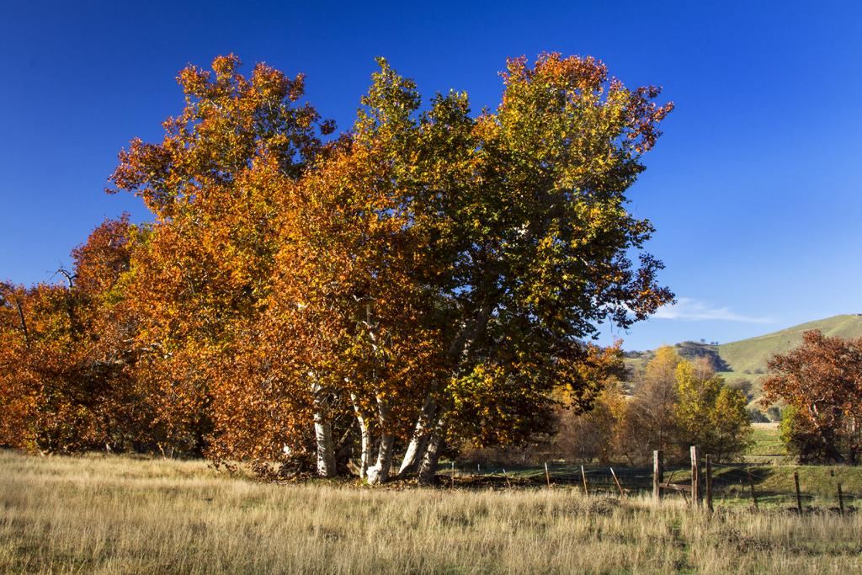
Conclusion
Photo: Greening, 2012.

